Slide 1
The Racial Wealth Gap
VIRTUAL LEARNING SIMULATION
Download the simulation at bread.org/simulation
Notes:
“Hi, everyone! I am really excited to be here with you today, so we can do the Racial Wealth Gap Learning Simulation together. The simulation was co-created by Bread for the World Institute, and is an interactive tool that helps folks understand racial inequality at the structural level and how it connects with social justice issues, like ending hunger and poverty. Let’s get started.”
Introduce Facilitators and Volunteer Team

Slide 2
The Racial Wealth Gap
VIRTUAL LEARNING SIMULATION
NOTE: We want to reaffirm that this is a simulation and NOT A GAME. We will be walking through a very sensitive historical journey. Therefore, we want to reiterate that what we are about to do is NOT A GAME. Instead, we want to invite you to refer to it as a simulation, experience, journey, or something to that affect.
Download the simulation at bread.org/simulation
Notes:
“We want to reaffirm that this is a simulation and NOT A GAME. We will be walking through a very sensitive historical journey. Therefore, we want to reiterate that what we are about to do is NOT A GAME. Instead, we want to invite you to refer to it as a simulation, experience, journey, or something to that affect.
This is important because sometimes participants say the word “game” when referring to this experience. It is not a game, and it is very real. In fact, it has had and continues to have very real implications on real people’s lives. Please lets go into this space with this truth, as we continue to learn together.”

Slide 3
Today’s roadmap!
Who is Bread for the World?
Opening Activity
Scope of Hunger and Poverty in U.S.
Racial Wealth Gap Learning Simulation!
Small Group Breakouts + Large Group Discussion
Download the simulation at bread.org/simulation
Notes:
Before we start the simulation, I wanted us to go through a road map of how we will be spending our time here together. First, we will cover who Bread for the World is (optional).
After that, we will have an opening activity! Then, we will review the scope of hunger and poverty in America so everyone is on the same page. The largest chunk of our time will be spent doing the simulation, and then we will wrap up by having a larger group discussion.
Before we go on, does anyone have any questions for how we will be spending our time together today?
Great!

Slide 4

Who is Bread for the World?
Bread for the World is a collective Christian voice urging elected officials on the Hill and in the administration to end hunger and poverty at home and abroad. by changing policies, programs, and conditions that allow hunger and poverty to persist. We believe it is important to address the root causes of hunger and poverty, racial inequality being one of them.
Download the simulation at bread.org/simulation
Notes:
Note: This is an optional slide. Put your own spin to it, but remember to mention our goal of ending hunger and poverty in the United States, and we understand that this cannot be achieved if we don’t promote racial equity.

Slide 5
Opening Activity: Group Questions
What brings everyone here today?
How does your church, organization, or community engage in anti-hunger or anti-poverty efforts?
Are you familiar with the racial wealth or income gap?
Are you familiar with the what racial equity means and why it is important?
Download the simulation at bread.org/simulation
Notes:
Consider doing this activity in the larger group and copy and past questions in chat.
Group Question(s):
What line of work everyone is involved in?
What brings everyone here today?
How does your church/organization/community engage in anti-hunger or anti-poverty efforts?
Are you familiar with the racial wealth or income gap?
Are you familiar with the what racial equity means and why it is important?

Slide 6
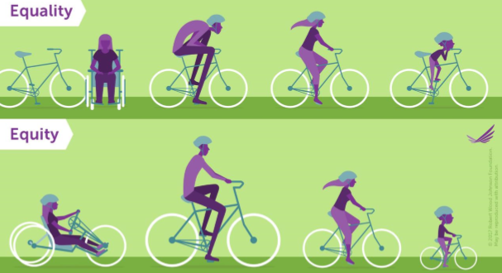
Opening Activity: What is Racial Equity?
In the same way, when we think about racial equity, we need to think about targeted approaches that account for:
Historical trauma
2. The 4 forms of racism
The barriers that disproportionately
hurt people of color, by race & ethnicity.
Download the simulation at bread.org/simulation
Notes:
“In this graphic, we see the difference between racial equality and racial equity. Racial equality is about giving everyone the same inputs without acknowledging needs and circumstances. This results in unequal outcomes. In the case of the graphic, not everyone is able to equally enjoy being able to ride their bikes optimally.
However, equity focuses on equal outcomes. But to achieve these outcomes, equity acknowledges that we need targeted inputs that consider needs and circumstances. In the graphic for equity, everyone receives the bikes that conforms to their needs and circumstances, and are therefore able to enjoy equal outcomes.
Racial equity is similar, since it focuses on achieving equal outcomes for communities of color relative to their white counterparts. To determine what these targeted inputs looks like, though, it is important to make sure that solutions are rooted in 3 things:
Historical Trauma. This term is essentially the history of racism for the last several centuries. Every community of color has a different history of racism and this must be acknowledged and discussed in any and all solutions considered.
The 4 forms of racism. There are four types of racism: personal, interpersonal, institutional and structural. People of color experience racism in all four forms on a daily basis. This also has to be addressed in all solutions considered.
The barriers that currently disproportionately hurt people of color. Lastly, we need to understand what the current barriers for people are color are now. This is heavily tied to the historical trauma that created these barriers and also tied to the four types of racism that sustain these barriers.
All of these aspects must be considered for each community of color individually to determine which bike each community needs, to eliminate the racial divides we see and achieve racial equity.”

Slide 7
What’s the Scope, Pre-COVID?
Before COVID-19, more than 35.2 million people in the U.S. faced hunger.
And over 34 million people lived below the poverty line.
Download the simulation at bread.org/simulation
Notes:
“Okay, so before I put it on the screen, do folks know how many people in the United States are currently experiencing hunger?” (Get responses from the audience, then show PPT)
After you receive responses: “Currently, the U.S. has over 35.2 million people who face hunger.” (You can choose to also ask folks who many people they think are living below the poverty line)
“34 million people live below the poverty line. That’s about one in 8 households, and down from about 4 million people from the last year this data was last collected so we are certainly heading in the right direction in terms of decreasing poverty levels in the U.S.” (You can choose whether to add that the same is true for hunger rates in the U.S., as we have also decreased food-insecurity by 1 million from last year to this year).
Note: The numbers do change annually. For the most current data on food-insecurity, please visit: https://www.ers.usda.gov/topics/food-nutrition-assistance/food-security-in-the-us/. For the most current data on poverty, please see the annual report from the U.S. Census Bureaus titled “Income and Poverty in the United States.”

Slide 8
What’s the Scope, Pre-COVID?
Before COVID-19, more than 35.2 million people in the U.S. faced hunger.
And over 34 million people lived below the poverty line.
50%
of people in the U.S could become poor
½ of U.S. households would face poverty if someone lost a job or got sick.
Download the simulation at bread.org/simulation
Notes:
“And a fact that many might not know is that, again, before the pandemic, 1 in 2 American households would face hunger or poverty if they lost a job or got sick. This is what we call liquid asset poverty. This essentially means that 50 percent of Americans could become poor, which really expands the scope of food insecurity. It means that hunger is something that not only low-income households are at risk of facing, but it goes beyond that.“

Slide 9
What’s the Scope as a result of COVID?
At the height of COVID-19……
More than 40 percent of people living in the U.S. faced hunger. Hunger increased by more than 3X due to COVID.
Over 17 percent of people in the U.S. lived below the poverty line.
Likely more than ½ of U.S. households would face poverty if someone lost a job or got sick.
85% +
of people in the U.S. could become poor
Download the simulation at bread.org/simulation
Notes:
“The slide before was the food insecurity data before the pandemic. Since COVID, this number has increased from about 14 percent to 40 percent. That is an increase of more than 3 times the rate it was before the pandemic.
In addition, compared to 10 percent of people living below the federal poverty line, COVID has nearly doubled the amount of people experiencing poverty.
Consequently, and while we are still receiving data on the impacts of COVID, it is safe to estimate that if 50 percent of people living in the U.S. were just one paycheck away from facing hunger and poverty if they lost a job or fell sick before the pandemic, that considering the fact that hunger and poverty rates doubled and tripled, that at least 85 percent (and likely higher) of people living in the U.S. are one paycheck away from experiencing hunger and poverty due to the pandemic.”
For more on this, see these resources:
“New Survey Explores Evolving Dynamics of Those Experiencing Food Insecurity for the First Time in COVID Era.” https://www.prnewswire.com/news-releases/new-survey-explores-evolving-dynamics-of-those-experiencing-food-insecurity-for-the-first-time-in-covid-era-301174188.html
How COVID Has Impacted Poverty in America. PBS. https://www.pbs.org/wgbh/frontline/article/covid-poverty-america/

Slide 10
What’s the Scope?
BEFORE the pandemic, people of color are more likely to face all three:
They are at least TWICE as likely to:
Experience hunger
Live below the poverty line
Be one paycheck away from becoming poor
DURING the pandemic, Black, Latino/a, and Indigenous households have become at least THREE as likely to experience these realities, compared to their white counterparts.
Download the simulation at bread.org/simulation
Notes:
“When we drill down into the numbers, we see that communities of color were at least 2 times as likely to face all three before the pandemic. They were more likely to experience hunger, poverty, or the susceptibility of falling into poverty.” (Optional: And when we account for intersectionality around gender, immigration status or status someone returning from jail or prison, then these rates can climb as high as 7 times as likely to experience hunger or poverty compared to the general population).
During the pandemic, according to preliminary findings from the Urban Institute, families of school-aged children with Black and Latino/a parents are three times as likely to report being food insecure as households headed by white parents during the pandemic (40.8 percent and 39.1 percent, respectively, compared to 15.1 percent). We expect the same to be true for Indigenous communities, although data has not been collected. Therefore, it is safe to say that instead of communities of color being AT LEAST twice as likely to experience these things, as a result of COVID, they are now AT LEAST three times as likely to experience these realities. (Optional: And when we account for intersectionality around gender, immigration status or status someone returning from jail or prison, then these rates would safely climb way higher than this.)
For more information on this, read “Racially Equitable Responses to COVID-19” from Marlysa D. Gamblin at Bread for the World Institute: https://bread.org/sites/default/files/downloads/racially-equitable-responses-to-hunger-during-covid-19-january-2021.pdf
For more information on this, read “Ending U.S. Hunger and Poverty by Focusing on Communities Where It’s Most Likely” available at: http://www.bread.org/sites/default/files/downloads/ending-us-hunger-marlysa-gamblin-march-2017.pdf

Slide 11
What’s the Scope?
BUT WHY??
The Racial Wealth and Income Divide!
Download the simulation at bread.org/simulation
Notes:
“But why? Why are communities of color at least twice as likely to experience hunger and poverty as the general population, before the pa? And why has this increased to AT LEAST three times as likely since the pandemic?
What do folks think. Just shout it out.” (Allow participants to respond and remember to probe them to dig deeper if they need to. After you have received a good number of responses, then repeat them back to the group).
“Okay, so we heard that X, X, X, X and X all contribute to why communities of color are at least twice as likely to face hunger and poverty. And I want to say, “yes!” you’re all correct!” (Click the animation for the box to appear)—”All of these factors contribute to what we know as the racial wealth and income divide.” (Explain how these factors contribute to the racial wealth and income divides so the group can connect the dots more).
“In addition, we have all seen how not addressing the racial wealth in a serious way before the pandemic has led to communities of color being the hardest hit by COVID-19, as we discussed earlier.”

Slide 12
Why This Simulation?
Wealth
Without wealth, you are more likely to experience poverty
Income and Poverty
When you experience poverty, you are more likely to experience hunger
Hunger
Download the simulation at bread.org/simulation
Notes:
“So, you might be asking yourself, ‘What does wealth have to do with hunger or poverty, or even general inequality?’
The way I like to think of wealth is as a buffer against hunger or poverty. If you have less wealth, then you are more likely to fall below the poverty line if you were to lose a job or get sick, for example. And when your income is low and you are experiencing poverty, and then you are more likely to face hunger. It is that simple.
So, let’s think back to when I said that Bread for the World believes it is possible to end hunger and poverty in the United States. But to do that, we must target and invest in communities that are most likely to experience hunger and poverty. To invest in communities of color and do this work both equitably and effectively, we must find solutions that get at the root causes. Why do communities of color face hunger at higher rates? To understand why this is the case, we must first understand the history of the racial wealth and income divide.”

Slide 13
Simulation Goals
Gain a better understanding of the racial wealth, income, and hunger gap, so that we can…..
Understand why racial equity is important to address structural inequality
Discuss racial equity within our organizations, congregations, and/or communities
Incorporate a racial equity lens into our daily work, life, worship, policies, practices, advocacy, etc.
Feel more comfortable explaining the importance of
applying a racial equity lens when working to end
hunger or poverty or achieve goals in other issue areas.
Download the simulation at bread.org/simulation
Notes:
“This is why I am so excited about the simulation—because through the simulation, we can understand this history, so that we are better equipped to identify equitable and effective solutions!
Today, I am hoping that we all gain a better understanding of the racial wealth, income, and hunger gap so that we can:
Understand why racial equity is important to address structural inequality.
Discuss racial equity within our organizations, congregations, and or communities.
Incorporate a racial equity lens into our daily work, life, worship, policies, practices, advocacy, etc.
Feel more comfortable explaining the importance of applying a racial equity lens when working to end hunger or poverty or achieve goals in other issue areas.”
*Note: Feel free to adapt this slide for your audience.

Slide 14




Instructions

Slide 15
Instructions for Virtual Simulation
We will begin with all participants in one group to read the policy cards. Some participants will be assigned a “white participant racial identity” role and some participants will be assigned a “Black participant racial identity” role. If everyone were physically in a room together, they would typically select the racial identity that is different from their own.
There are three action cards (“money,” “land,” and “opportunity lost”) and 13 policy cards. The facilitator will invite volunteers to read a policy card aloud. After each, the facilitator will read the action(s) on the card for participants to carry out. Show the action on a shared screen and pause briefly so that everyone can read the action. In each round, everyone will be asked to add or subtract one, two, or all three cards. Participants are invited (but not required) to use an Action Card Tracker to keep track of their money, land, and opportunity lost cards. At the end, we will count how many money, land, and opportunity lost cards everyone has.
The facilitator may choose whether to use breakout rooms after all 13 policy cards have been read and the final scores counted, OR at intervals throughout this process. With this option, we suggest stopping after policy 4 and policy 8 for breakout sessions. Each breakout group should have no more than 10 participants. After the breakout discussions are finished, there will be a concluding discussion with all participants.
Notes:
NOTES TO FACILITAOR:
There are multiple ways for determining which race identity role each participant will receive. Please see the four options below. To review the corresponding talking points under each option, please review the Virtual Facilitator’s and Planning Guide under FAQ 17:
Option 1: Last Name Method. Everyone with last names ending in A-K receives a “Black participant race” role and everyone with last names ending in L-Z receive a “white participant race” role. You can decide if you want to invite them to rename themselves by putting a “B” or “W” in front of their name, or if you want to invite your technology volunteer to do that for everyone based on their last name. This is perhaps one of the easiest options. Option 2: Participant Self Selection. You invite everyone to select for themselves what race participant role they would like. With this, you can encourage folks to select a race identify role different than the one in which they currently identify as. However, if the group is racially homogenous, this self-selection may not be the best option. With this option, it is probably best to invite people to put “W” or “B” in front of their names to align with the corresponding racial identify role they select. This is also perhaps one of the easiest options.
Option 3: Facilitator's Choice. The technology volunteer will randomly rename participants to a group “1” or “2” at the beginning of the simulation before the instructions are read out. The facilitator will then reveal that everyone who was assigned a “1” by the technology volunteer has received a “Black participant racial identity” role and everyone who was assigned a “2” by the technology volunteer has received a “white participant racial identity” role.
Option 4: Opposites Attract. This option only works if your group is racially diverse. You assign the opposite racial identity role to people of the opposite racial background. So, Black participants would be assigned “white participant identity race” roles and white participant would be assigned “Black identity race” roles. For people who neither identify as white or Black, they would have the option of choosing which racial identity role they would like. With this option, it is probably best to invite people to put “W” or “B” in front of their names to align with the corresponding racial identify role they are assigned to (for Black and white participants) and the role that they select (for non-Black and non-white participants).
REMEMBER
Language Choices: Use language like “those of you in the role of a ‘Black participant racial identity’ and refrain from language like “Black participants.” we want to affirm that non-Black participants assigned a “Black participant racial identity” role do not and will not ever know what it means to experience life as a Black person. Please be mindful and correct participants that make this language misstep. People are assigned to racial identity roles, but are not “Black” or “Black participants.”
Small Group Breakout Sessions: To determine how many people should be in each small group breakout session and how long each session should last based on group size, please refer to the Virtual Facilitator's and Planning Guide FAQ # 13.
Action Card Tracker: Here are some helpful talking points to help you explain the Action Card Tracker. Please refer to the Virtual Facilitator's and Planning Guide FAQ # 15.
“We recognize that everyone learns and engages in this material differently. Some of us are audio learners, some of us learn by writing, and some of us learn by doing. For those of us who need to virtually keep track of how many actions cards are subtracted and added each round, you have the option of using the Action Card Tracker. This was sent out in the email to everyone who registered. Before you start, remember to mark whether you were assigned into a “Black participant race” role or a “white participant race” role. You should be able to do this on the tool. If you are using this tool virtually, then feel free to use your computer to move a money, land or opportunity lost card into your virtual bank when a card is added to your participant identification role. And when an action card is subtracted from this role, then just put the corresponding action card back up top. This is the easiest way and doesn’t require that you have a printer. If you have printed this tool, then consider tallying how many money, land and opportunity lost cards you have in each round.”

Slide 16
Policy # 1
Land Seizures (1865-Present Day)
Notes:
Volunteer reader reads this title aloud.

Slide 17
Policy #1 Andrew Johnson’s Land Policies and Sharecropping
After the Civil War, only 30,000 African Americans owned small plots of land, compared to 4 million who did not because an 1865 federal law rescinded the government’s promise of 40 acres of land for former slaves. These 4 million blacks largely resorted to renting the farm land of their previous master in exchange for a “share” of their crop. This system of “sharecropping” tied farmers to their former master because they were legally obligated to BUY all farming materials (usually at higher prices) and SELL their farming crops solely to their former master (usually at lower prices).
ACTION
Black participants
Add one land card and one money card to represent the less than 1 percent of African Americans who were able to own land and not face debt after slavery. Unfortunately, Black participants should also add four lost opportunity cards for the 4 million African Americans who had to sharecrop and were denied the initial promise of land ownership. Buying farm supplies from the landowner at higher prices, only to sell their crops back at lower prices, resulted in African Americans facing higher levels of debt and higher rates of hunger.
Notes:
Volunteer reader reads this policy aloud.

Slide 18
Policy #1 Andrew Johnson’s Land Policies and Sharecropping
After the Civil War, only 30,000 African Americans owned small plots of land, compared to 4 million who did not because an 1865 federal law rescinded the government’s promise of 40 acres of land for former slaves. These 4 million blacks largely resorted to renting the farm land of their previous master in exchange for a “share” of their crop. This system of “sharecropping” tied farmers to their former master because they were legally obligated to BUY all farming materials (usually at higher prices) and SELL their farming crops solely to their former master (usually at lower prices).
ACTION
Black participants
Add one land card and one money card to represent the less than 1 percent of African Americans who were able to own land and not face debt after slavery. Unfortunately, Black participants should also add four lost opportunity cards for the 4 million African Americans who had to sharecrop and were denied the initial promise of land ownership. Buying farm supplies from the landowner at higher prices, only to sell their crops back at lower prices, resulted in African Americans facing higher levels of debt and higher rates of hunger.
Notes:
Facilitator reads the action cards to the group and invite those using the tracker to take their actions.

Slide 19



Black Participants
White Participants

Slide 20
Policy # 2
Andrew Johnson’s Land Policies
and Sharecropping (1865-1880)
Notes:
Volunteer reader reads this title aloud.

Slide 21
Policy #2 Land Seizures
From 1865 on, Blacks could have their land seized to pay sharecropping debts—or simply because white landowners declared that Black farmers or businesses were in debt. Blacks could not fight these charges because they were legally prohibited from suing whites in court. In addition, from 1949-1970, one million people lost their land to abuses of the power of eminent domain, which allows local governments to seize private property. About 70 percent of these families were African American.
ACTION
White participants
Add one land card and two money cards for having the legal ability to seize the land of black farmers and business owners, increasing your income and reducing your vulnerability to hunger.
Black participants
Subtract a land card for the land lost under land seizures. Also subtract a money card for the tens of millions of dollars lost from no longer having land to help earn an income and grow food to eat.
Notes:
Volunteer reader reads this policy aloud.

Slide 22
Policy #2 Land Seizures
From 1865 on, Blacks could have their land seized to pay sharecropping debts—or simply because white landowners declared that Black farmers or businesses were in debt. Blacks could not fight these charges because they were legally prohibited from suing whites in court. In addition, from 1949-1970, one million people lost their land to abuses of the power of eminent domain, which allows local governments to seize private property. About 70 percent of these families were African American.
ACTION
White participants
Add one land card and two money cards for having the legal ability to seize the land of black farmers and business owners, increasing your income and reducing your vulnerability to hunger.
Black participants
Subtract a land card for the land lost under land seizures. Also subtract a money card for the tens of millions of dollars lost from no longer having land to help earn an income and grow food to eat.
Notes:
Facilitator reads the action cards to the group and invite those using the tracker to take their actions.

Slide 23
Black Participants
White Participants

Slide 24
Policy # 3
The National Housing Act of 1934,
Part 1
Notes:
Volunteer reader reads this title aloud.

Slide 25
Policy #3 The National Housing Act of 1934, Part 1
Policies under this law guaranteed federally-backed loans to whites and legally refused loans to blacks and anyone else who chose to live in or near Black neighborhoods. This practice, known as “redlining,” targeted entire Black neighborhoods and identified them as “Grade D.” This made it nearly impossible for appraisers in the private sector to do business in Black neighborhoods because all the residents were considered bad credit risks.
ACTION
White participants
Add one land card and one money card for the equity gained in purchasing homes not near black neighborhoods. Equity increased a family’s ability to save for future needs.
Black participants
Do not add any land cards because of the inability to purchase homes. Do not add any money cards since it was illegal to lend to Blacks, preventing them from building equity and weakening their ability to save for future needs.
Notes:
Volunteer reader reads this policy aloud.

Slide 26
Policy #3 The National Housing Act of 1934, Part 1
Policies under this law guaranteed federally-backed loans to whites and legally refused loans to blacks and anyone else who chose to live in or near Black neighborhoods. This practice, known as “redlining,” targeted entire Black neighborhoods and identified them as “Grade D.” This made it nearly impossible for appraisers in the private sector to do business in Black neighborhoods because all the residents were considered bad credit risks.
ACTION
White participants
Add one land card and one money card for the equity gained in purchasing homes not near black neighborhoods. Equity increased a family’s ability to save for future needs.
Black participants
Do not add any land cards because of the inability to purchase homes. Do not add any money cards since it was illegal to lend to Blacks, preventing them from building equity and weakening their ability to save for future needs.
Notes:
Facilitator reads the action cards to the group and invite those using the tracker to take their actions.

Slide 27
Black Participants
White Participants

Slide 28
Policy # 4
The National Housing Act of 1934,
Part 2
Notes:
Volunteer reader reads this title aloud.

Slide 29
Policy #4 The National Housing Act of 1934, Part 2
Since this legislation prevented blacks from receiving federally-backed home mortgages, whites usually purchased homes in black neighborhoods and then sold “housing contracts” to blacks who wanted to become homeowners, often for two or three times the amount of the mortgage. These contracts only guaranteed black families the rights to the house AFTER all the payments were complete. Missing even one payment, or being late, would result in the black family losing their house immediately.
ACTION
White participants
Add two land cards for being able to legally purchase homes at the market rate, and pick up two money cards for the equity earned from homeownership.
Black participants
Add one land card for signing a contract for a home in hopes of becoming a homeowner one day. Do not add any money cards because contracts stripped additional income and wealth from several generations. Also add one lost opportunity card because of the higher interest paid and less equity earned once the home was actually purchased.
Notes:
Volunteer reader reads this policy aloud.

Slide 30
Policy #4 The National Housing Act of 1934, Part 2
Since this legislation prevented blacks from receiving federally-backed home mortgages, whites usually purchased homes in black neighborhoods and then sold “housing contracts” to blacks who wanted to become homeowners, often for two or three times the amount of the mortgage. These contracts only guaranteed black families the rights to the house AFTER all the payments were complete. Missing even one payment, or being late, would result in the black family losing their house immediately.
ACTION
White participants
Add two land cards for being able to legally purchase homes at the market rate, and pick up two money cards for the equity earned from homeownership.
Black participants
Add one land card for signing a contract for a home in hopes of becoming a homeowner one day. Do not add any money cards because contracts stripped additional income and wealth from several generations. Also add one lost opportunity card because of the higher interest paid and less equity earned once the home was actually purchased.
Notes:
Facilitator reads the action cards to the group and invite those using the tracker to take their actions.

Slide 31
Black Participants
White Participants
Notes:
OPTIONAL: If the facilitator has chosen to hold three breakout sessions, then after reviewing Policy #4, the facilitator can decide to send the participants into their first small group breakout session and have them discuss these questions. Also consider providing these questions in the chat. Note: These are also provided in the Virtual Facilitation and Planning Guide in FAQ #14:
Questions to ask after Policy #4
How are you feeling?
What did you learn that you didn’t know before?
What did you learn that affirmed what you already know?

Slide 32
Policy # 5
The Social Security Act (1935)
Notes:
Volunteer reader reads this title aloud.

Slide 33
Policy #5 The Social Security Act
This act excluded farmworkers and domestic workers, who were predominantly Black, from receiving old age and unemployment insurance. Although Social Security was meant to help those affected by the Great Depression, and African Americans were twice as likely as the “average” American family to face hunger during this time, 65 percent of African Americans were ineligible to receive Social Security.
ACTION
White participants
Add one money card for being able to benefit from unemployment and old age insurance during a very grim time in American history.
Black participants
Add one lost opportunity card for the inability to benefit from unemployment insurance even though African Americans were between two and three times as likely as whites to experience poverty and hunger.
Notes:
Volunteer reader reads this policy aloud.

Slide 34
Policy #5 The Social Security Act
This act excluded farmworkers and domestic workers, who were predominantly Black, from receiving old age and unemployment insurance. Although Social Security was meant to help those affected by the Great Depression, and African Americans were twice as likely as the “average” American family to face hunger during this time, 65 percent of African Americans were ineligible to receive Social Security.
ACTION
White participants
Add one money card for being able to benefit from unemployment and old age insurance during a very grim time in American history.
Black participants
Add one lost opportunity card for the inability to benefit from unemployment insurance even though African Americans were between two and three times as likely as whites to experience poverty and hunger.
Notes:
Facilitator reads the action cards to the group and invite those using the tracker to take their actions.

Slide 35
Black Participants
White Participants

Slide 36
Policy # 6
The Fair Labor Standards
Act of 1938
Notes:
Volunteer reader reads this title aloud.

Slide 37
Policy #6 The Fair Labor Standards Act of 1938
This was enacted to help bolster the economy and get the country out of the Great Depression, but it excluded tip-based jobs and other jobs predominantly held by Black workers—including servers, shoe shiners, domestic workers, and Pullman porters—from this first-ever minimum wage legislation. Even though the Black unemployment, hunger, and poverty rates were at least twice those of whites during the Great Depression, the very policies meant to alleviate economic strain were withheld from the Black community.
ACTION
White participants
Add one money card for benefiting from the minimum wage to make their families less susceptible to hunger and poverty.
Black participants
Add one lost opportunity card for being stuck in tip-based occupations that did not offer a minimum wage to help families survive during the Great Depression. This made it even harder for them to get back on their feet and build for the future.
Notes:
Volunteer reader reads this policy aloud.

Slide 38
Policy #6 The Fair Labor Standards Act of 1938
This was enacted to help bolster the economy and get the country out of the Great Depression, but it excluded tip-based jobs and other jobs predominantly held by Black workers—including servers, shoe shiners, domestic workers, and Pullman porters—from this first-ever minimum wage legislation. Even though the Black unemployment, hunger, and poverty rates were at least twice those of whites during the Great Depression, the very policies meant to alleviate economic strain were withheld from the Black community.
ACTION
White participants
Add one money card for benefiting from the minimum wage to make their families less susceptible to hunger and poverty.
Black participants
Add one lost opportunity card for being stuck in tip-based occupations that did not offer a minimum wage to help families survive during the Great Depression. This made it even harder for them to get back on their feet and build for the future.
Notes:
Facilitator reads the action cards to the group and invite those using the tracker to take their actions.

Slide 39
Black Participants
White Participants

Slide 40
Policy # 7
The G.I. Bill of 1944
Notes:
Volunteer reader reads this title aloud.

Slide 41
Policy #7 The G. I. Bill of 1944
This was enacted to help World War II veterans adjust to civilian life by providing low-cost home mortgages, low-interest business loans, tuition assistance, and unemployment insurance. Unfortunately, Black veterans were excluded from many of these benefits.
ACTION
White participants
Add two money cards and one land card for the opportunities you received, such as government-guaranteed housing loans, which helped to build the American “middle class.”
Black participants
Only one Black participant adds a money card, representing the few African Americans who had access to some benefits of the GI Bill. All Black participants add one lost opportunity card for not being able to benefit from the GI Bill even though they too had fought for the United States in World War II.
Notes:
Volunteer reader reads this policy aloud.

Slide 42
Policy #7 The G. I. Bill of 1944
This was enacted to help World War II veterans adjust to civilian life by providing low-cost home mortgages, low-interest business loans, tuition assistance, and unemployment insurance. Unfortunately, Black veterans were excluded from many of these benefits.
ACTION
White participants
Add two money cards and one land card for the opportunities you received, such as government-guaranteed housing loans, which helped to build the American “middle class.”
Black participants
Only one Black participant adds a money card, representing the few African Americans who had access to some benefits of the GI Bill. All Black participants add one lost opportunity card for not being able to benefit from the GI Bill even though they too had fought for the United States in World War II.
Notes:
Facilitator reads the action cards to the group and invite those using the tracker to take their actions.

Slide 43
Black Participants
(Only one participant)
White Participants

Slide 44
Policy # 8
Overturn of “Separate but Equal” Doctrine (1954 to Present Day)
Notes:
Volunteer reader reads this title aloud.

Slide 45
Policy #8 Overturn of “Separate but Equal” Doctrine
Although the “Separate but Equal” Doctrine was declared unconstitutional in 1954 (Brown vs. Board of Education), American schools are more racially segregated today than at any other time in the past four decades. Academic success is less likely in predominately low-income Black neighborhoods. Black students are five times as likely to live in an area of concentrated poverty, with underfunded, understaffed, and overcrowded schools. This leaves Black students with limited education, and many often settle for minimum-wage jobs that offer little hope of advancement or better pay.
ACTION
White participants
Add two money cards for having up to $733 higher annual per-student spending on education than Black students. This contributes to a greater likelihood of attending college and later getting a higher-paying job.
Black participants
Add only one money card to represent the 75 percent high school graduation rate among African American students, compared to 88 percent among white students. Also pick up one lost opportunity card for the lower student spending that helps funnel many Black students into low-wage work after high school.
Notes:
Volunteer reader reads this policy aloud.

Slide 46
Policy #8 Overturn of “Separate but Equal” Doctrine
Although the “Separate but Equal” Doctrine was declared unconstitutional in 1954 (Brown vs. Board of Education), American schools are more racially segregated today than at any other time in the past four decades. Academic success is less likely in predominately low-income Black neighborhoods. Black students are five times as likely to live in an area of concentrated poverty, with underfunded, understaffed, and overcrowded schools. This leaves Black students with limited education, and many often settle for minimum-wage jobs that offer little hope of advancement or better pay.
ACTION
White participants
Add two money cards for having up to $733 higher annual per-student spending on education than Black students. This contributes to a greater likelihood of attending college and later getting a higher-paying job.
Black participants
Add only one money card to represent the 75 percent high school graduation rate among African American students, compared to 88 percent among white students. Also pick up one lost opportunity card for the lower student spending that helps funnel many Black students into low-wage work after high school.
Notes:
Facilitator reads the action cards to the group and invite those using the tracker to take their actions.

Slide 47
Black Participants
(Only one participant)
White Participants
Notes:
OPTIONAL: If the facilitator has chosen to hold three breakout sessions, then after reviewing Policy #4, the facilitator can decide to send the participants into their first small group breakout session and have them discuss these questions. Also consider providing these questions in the chat. Note: These are also provided in the Virtual Facilitation and Planning Guide in FAQ #14:
Questions to ask after Policy #8
How are you feeling?
What did you learn that you didn’t know before?
What did you learn that affirmed what you already know?

Slide 48
Policy # 9
Subprime Loans
(1970s to Present Day)
Notes:
Volunteer reader reads this title aloud.

Slide 49
Policy #9 Subprime Loans
Starting in the 1970s and continuing today, the private sector issued subprime loans (loans with higher interest rates) to Black families almost exclusively—regardless of a family’s income, education, or good credit history. As a result, Blacks continue to unfairly pay more for homes of the same value as their white counterparts. This increases foreclosure rates among Blacks, which also contributes to higher food insecurity levels.
ACTION
White participants
Add two land cards and two money cards for securing good interest rates on homes.
Black participants
Blacks were forced into subprime mortgages as their only option for more than three generations—stripping income and wealth from the Black community. High-income Blacks were 80 percent more likely to lose their homes than high-income whites when the housing bubble burst in 2008, and 240,000 Blacks lost their homes. Therefore, Black participants add only one land card and one money card.
Notes:
Volunteer reader reads this policy aloud.

Slide 50
Policy #9 Subprime Loans
Starting in the 1970s and continuing today, the private sector issued subprime loans (loans with higher interest rates) to Black families almost exclusively—regardless of a family’s income, education, or good credit history. As a result, Blacks continue to unfairly pay more for homes of the same value as their white counterparts. This increases foreclosure rates among Blacks, which also contributes to higher food insecurity levels.
ACTION
White participants
Add two land cards and two money cards for securing good interest rates on homes.
Black participants
Blacks were forced into subprime mortgages as their only option for more than three generations—stripping income and wealth from the Black community. High-income Blacks were 80 percent more likely to lose their homes than high-income whites when the housing bubble burst in 2008, and 240,000 Blacks lost their homes. Therefore, Black participants add only one land card and one money card.
Notes:
Facilitator reads the action cards to the group and invite those using the tracker to take their actions.

Slide 51
Black Participants
(Only one participant)
White Participants

Slide 52
Policy # 1 0
The War on Drugs
(1971 to Present Day)
Notes:
Volunteer reader reads this title aloud.

Slide 53
Policy #10 The War on Drugs
The War on Drugs, initiated in 1971 and continuing today, widened the racial wealth gap with policies targeting Black and Brown communities. Although rates of using and selling drugs are comparable across racial lines, Blacks are up to 10 times as likely to be stopped, searched, arrested, prosecuted, convicted, and/or incarcerated for drug violations as whites. Since this means that Black families are up to 10 times as likely to have a family member sent to prison, they are more than 10 times as likely to fall into hunger because of incarceration.
ACTION
White participants
Subtract two money cards for the more than $180 billion in tax dollars that it costs to maintain mass incarceration today. Also add one lost opportunity card since these taxpayer dollars could instead be used to support programs that end hunger and poverty in the United States.
Black participants
Combined, debt and property depreciation increase hunger and poverty rates within the Black community. Subtract two money cards for being more likely to be incarcerated than whites and owing debts of about $13,000 per household in fees and court costs when a family member is incarcerated. Subtract one land card for the estimated $11 billion in lower property values in many African American communities caused by the return of large numbers of people from jail or prison.
Notes:
Volunteer reader reads this policy aloud.

Slide 54
Policy #10 The War on Drugs
The War on Drugs, initiated in 1971 and continuing today, widened the racial wealth gap with policies targeting Black and Brown communities. Although rates of using and selling drugs are comparable across racial lines, Blacks are up to 10 times as likely to be stopped, searched, arrested, prosecuted, convicted, and/or incarcerated for drug violations as whites. Since this means that Black families are up to 10 times as likely to have a family member sent to prison, they are more than 10 times as likely to fall into hunger because of incarceration.
ACTION
White participants
Subtract two money cards for the more than $180 billion in tax dollars that it costs to maintain mass incarceration today. Also add one lost opportunity card since these taxpayer dollars could instead be used to support programs that end hunger and poverty in the United States.
Black participants
Combined, debt and property depreciation increase hunger and poverty rates within the Black community. Subtract two money cards for being more likely to be incarcerated than whites and owing debts of about $13,000 per household in fees and court costs when a family member is incarcerated. Subtract one land card for the estimated $11 billion in lower property values in many African American communities caused by the return of large numbers of people from jail or prison.
Notes:
Facilitator reads the action cards to the group and invite those using the tracker to take their actions.

Slide 55
Black Participants
(Only one participant)
White Participants

Slide 56
Policy # 1 1
Life After Incarceration
Consequences of the War on Drugs
(Present Day)
Notes:
Volunteer reader reads this title aloud.

Slide 57
Policy #11 Life After Incarceration—Consequences of the War on Drugs
When people are released from jail or prison, they are hoping for a second chance. But they face more than 48,000 separate restrictions, known as collateral consequences. Some examples of lifelong penalties include being denied the right to vote in some states, being
prohibited from applying to higher-paying jobs, being ineligible to participate in social safety net programs such as SNAP (the Supplemental Nutrition Assistance Program, formerly food stamps), and other restrictions, such as being banned from getting a barber’s license. Since Blacks are up to 10 times as likely as whites to be stopped, arrested, and sentenced, they are also up to 10 times as likely to face these restrictions.
ACTION
Black participants
There are five times as many Blacks as whites returning home with criminal records. Add two lost opportunity cards to represent how Black communities are more likely to fall into hunger because so many returnees are unable to reintegrate into society, get a job, and/or access SNAP benefits.
Notes:
Volunteer reader reads this policy aloud.

Slide 58
Policy #11 Life After Incarceration—Consequences of the War on Drugs
When people are released from jail or prison, they are hoping for a second chance. But they face more than 48,000 separate restrictions, known as collateral consequences. Some examples of lifelong penalties include being denied the right to vote in some states, being
prohibited from applying to higher-paying jobs, being ineligible to participate in social safety net programs such as SNAP (the Supplemental Nutrition Assistance Program, formerly food stamps), and other restrictions, such as being banned from getting a barber’s license. Since Blacks are up to 10 times as likely as whites to be stopped, arrested, and sentenced, they are also up to 10 times as likely to face these restrictions.
ACTION
Black participants
There are five times as many Blacks as whites returning home with criminal records. Add two lost opportunity cards to represent how Black communities are more likely to fall into hunger because so many returnees are unable to reintegrate into society, get a job, and/or access SNAP benefits.
Notes:
Facilitator reads the action cards to the group and invite those using the tracker to take their actions.

Slide 59
Black Participants
(Only one participant)
White Participants

Slide 60
Policy # 1 2
Employment Discrimination
(Present Day)
Notes:
Volunteer reader reads this title aloud.

Slide 61
Policy #12 Employment Discrimination
Although racial discrimination in the workforce was legally abolished in 1964 with the Civil Rights Act, racial discrimination continues among all educational levels and job sectors. For example, Blacks are twice as likely not to be called back after they complete job applications or interviews. In addition, the gap between the hourly pay of blacks and whites has grown from $3.55/hour in 1979 to $6.73/hour in 2016.
ACTION
White participants
Add two money cards for being twice as likely to receive a call back for a job and for earning an average of $14,000 a year more than your Black peers.
Black participants
Add two lost opportunity cards for being two times less likely to receive a job callback and for earning an average of $14,000 a year less than your white peers. Doing the math shows that racial discrimination in the workforce costs Black workers at least $600,000 over the course of their working years.
Notes:
Volunteer reader reads this policy aloud.

Slide 62
Policy #12 Employment Discrimination
Although racial discrimination in the workforce was legally abolished in 1964 with the Civil Rights Act, racial discrimination continues among all educational levels and job sectors. For example, Blacks are twice as likely not to be called back after they complete job applications or interviews. In addition, the gap between the hourly pay of blacks and whites has grown from $3.55/hour in 1979 to $6.73/hour in 2016.
ACTION
White participants
Add two money cards for being twice as likely to receive a call back for a job and for earning an average of $14,000 a year more than your Black peers.
Black participants
Add two lost opportunity cards for being two times less likely to receive a job callback and for earning an average of $14,000 a year less than your white peers. Doing the math shows that racial discrimination in the workforce costs Black workers at least $600,000 over the course of their working years.
Notes:
Facilitator reads the action cards to the group and invite those using the tracker to take their actions.

Slide 63
Black Participants
(Only one participant)
White Participants

Slide 64
Policy # 1 3
The Voting Restrictions
(1890 to Present Day)
Notes:
Volunteer reader reads this title aloud.

Slide 65
Policy #13 Voting Restrictions
Voting is key to ending hunger. As early as 1890, blacks faced organized campaigns to prevent them from voting, including biased “literacy tests,” poll taxes, and lynching. In 1965, the Voting Rights Act passed, making efforts to prevent voting illegal. Today, people returning from jail or prison (who are disproportionately Black) are denied the right to vote in many states. In addition, as recently as 2017, states have proposed “Voter ID” laws, which would require voters to have government-issued identification. It is more difficult for African Americans to obtain these—one in four face barriers, compared with one in 10 whites. Barriers include, for example, having to pay up to $150 for an acceptable copy of a birth certificate and Social Security card, travel costs, and time taken off from work.
ACTION
Black participants
Add one lost opportunity card for: (1) being prevented from voting in the early 1900s, when the votes of Black people might have prevented some of the harmful laws mentioned in this simulation from being enacted, & (2) still facing voting restrictions that disproportionately impact black communities and weaken efforts to improve policies that end hunger and poverty.
Notes:
Volunteer reader reads this policy aloud.

Slide 66
Policy #13 Voting Restrictions
Voting is key to ending hunger. As early as 1890, blacks faced organized campaigns to prevent them from voting, including biased “literacy tests,” poll taxes, and lynching. In 1965, the Voting Rights Act passed, making efforts to prevent voting illegal. Today, people returning from jail or prison (who are disproportionately Black) are denied the right to vote in many states. In addition, as recently as 2017, states have proposed “Voter ID” laws, which would require voters to have government-issued identification. It is more difficult for African Americans to obtain these—one in four face barriers, compared with one in 10 whites. Barriers include, for example, having to pay up to $150 for an acceptable copy of a birth certificate and Social Security card, travel costs, and time taken off from work.
ACTION
Black participants
Add one lost opportunity card for: (1) being prevented from voting in the early 1900s, when the votes of Black people might have prevented some of the harmful laws mentioned in this simulation from being enacted, & (2) still facing voting restrictions that disproportionately impact black communities and weaken efforts to improve policies that end hunger and poverty.
Notes:
Facilitator reads the action cards to the group and invite those using the tracker to take their actions.

Slide 67
Black Participants
(Only one participant)
White Participants

Slide 68
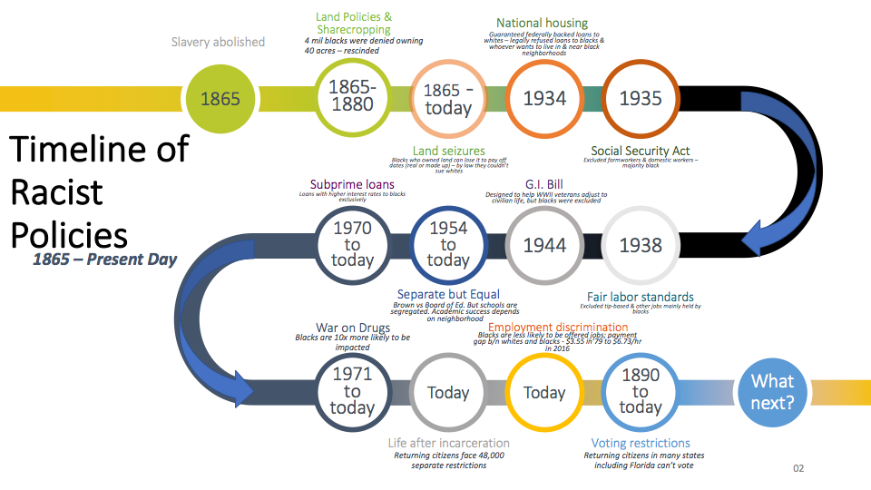
Graphic created by Mariam Mengistie, Executive Director of Missions St. Luke’s United Methodist Church in Orlando, FL and long time Bread for the World Member
Notes:
“This graphic really sums up everything we have learned in our time together.”

Slide 69
The Racial Wealth Gap
How many money cards did everyone end up with?
Download the simulation at bread.org/simulation
Notes:
“I heard a lot of great discussion so I am excited to delve in. Can someone share how many money cards you ended up with and what participant card you had? Okay, great! What about others with a different participant card?” [Wait until participants share their responses]
“Great…We see a result of $13 for those with white participant cards and $1 for those with black participant cards, and the other half of those with black participant cards had zero money cards. This 13:1 is the ratio of their average net wealth. How many of you think this ratio is accurate in real life? Is it lower or higher in the United States today, or is it correct?” [Get a sense of responses in the room and then go to the next slide].

Slide 70



Final Results
Black Participants
White Participants
(For one participant)
Download the simulation at bread.org/simulation

Slide 71
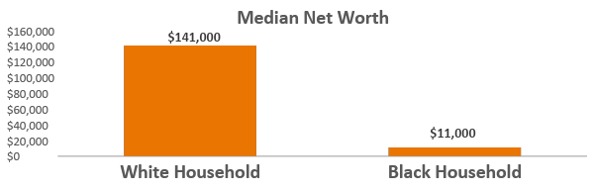
The Racial Wealth Gap
(In 2013 Dollars)
13:1 Ratio
Source: http://www.pewresearch.org/fact-tank/2014/12/12/racial-wealth-gaps-great-recession/
Download the simulation at bread.org/simulation
Notes:
“Well, this 13:1 ratio in net wealth is actually correct. In real U.S. dollars, white households have a net worth 13 times the net worth of black households. I want to point out that this is not what every white family or every black family has—most likely, few if any actual families have this ratio. It is the “typical” amount – for the household that falls in the middle of the wealth spectrum. We use this to illustrate the overall impact of federal policies that either enable different communities to build wealth, or hinder or prevent them from doing so. It also explains today’s levels of food insecurity in communities of color.
Okay, so I have one more question for you. For the most households experiencing food insecurity, living at or near the poverty line, do you all think there is this same wealth gap? (Get a sense from folks in the room).
Optional: How much wealth do you think white households have? What about Black households?

Slide 72
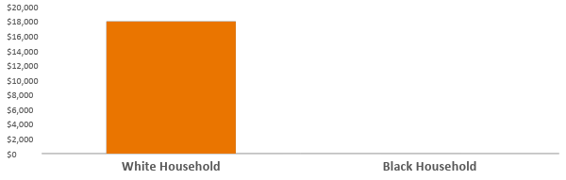
Racial Wealth Gap!
Median Net Worth Among Households Living Near the Poverty Line
$18,000
18,000:0 Ratio
$0
Source: https://socialequity.duke.edu/sites/socialequity.duke.edu/files/site-images/FINAL%20 COMPLETE%20REPORT_.pdf4 U.S. Federal Poverty Guidelines Used
Download the simulation at bread.org/simulation
Notes:
“In this slide, we see that among the lowest earners, white households have a median net worth of $18,000, while black families have a median net wealth of near zero. Among this group, we see that the wealth gap is actually larger — $18,000 to $0.
Where do you all think this wealth is coming from, given what we reviewed in the simulation?” (Group responses)
“Great! A lot of what I think we are seeing, which some folks hinted at in their responses, is the inheritance of wealth from generation to generation, most likely in the form of land or property like a house. The reason half the participants with a black racial identity card ended up with zero money cards, is to indicate the extreme wealth gap among the most financially vulnerable households in our country. It shows how pervasive the impact of racial inequality has been when we see that it exists at all income levels. This shows how important it is to apply a racial equity lens to our work in order to move forward.
Let’s go on to the large group discussion questions.”

Slide 73
Discuss in Breakout Groups
Want to access the Policy Packet explaining all 13 policies in more depth? Download it at bread.org/simulation_policypacket
*NOTE: If your group has less than 15 participants, feel free to discuss these questions as a larger group. If your group is larger than 15 participants, Bread for the World Institute recommends (though this is optional) using smaller breakout rooms with no more than 10 people per breakout to discuss the questions below. Then, regroup with the large group to review the next steps (see next slides).
1. What did you learn that you didn’t know before?
2. What trends did you see in this simulation?
3. How do you see the racial wealth and income divides play out in your own communities?
4. How does this impact your work to end hunger/poverty or engage in other work in your community?
5. What did you learn about the importance of racial equity?
6. How can you incorporate a racial equity lens into your daily work, life, worship, policies, practices, advocacy, etc.?
Download the simulation at bread.org/simulation
Notes:
NOTE TO FACILITATOR: Copy and past the questions featured in the slide in the chat feature of your breakout room session, for the participants to discuss.
REMEMBER:
Feel free to adapt these questions as you need to for the group. For additional questions, please see the original facilitator’s guide, on page 19, which can be accessed at bread.org/simulation_facilitatorsguide.
For a list of trends identified in the simulation, please read page 4 of the Policy Packet, which can be accessed at bread.org/simulation_policypacket.Knowing these trends might be helpful to help guide the discuss along once participants are brought back in the larger group to discuss.

Slide 74
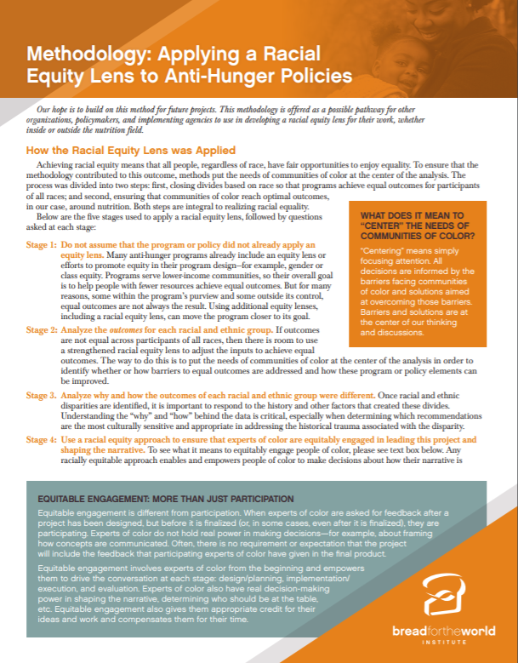
Next Steps
What’s the Next Step???
Applying Racial Equity……
But How???
Let’s look at the Racial Equity Methodology (bread.org/racialequity)
Download the simulation at bread.org/simulation
Notes:
“By now, many of us are asking ourselves, ‘what’s next?’ This is a good question. The next thing is to do the opposite of what we saw in the simulation, to help correct the wrongs committed and the harm done. We dismantle racism by promoting racial equity.
The Racial Equity Methodology Tool is a tool that can help you promote racial equity in your processes, projects and in your research. You can find it at bread.org/racialequity. The designer of the simulation is also the author of this tool as a follow up for what is needed after doing the simulation.”
Methodology Link: https://d1w64so4kzmym9.cloudfront.net/institute/report/racial-equity/report-methodology.pdf

Slide 75
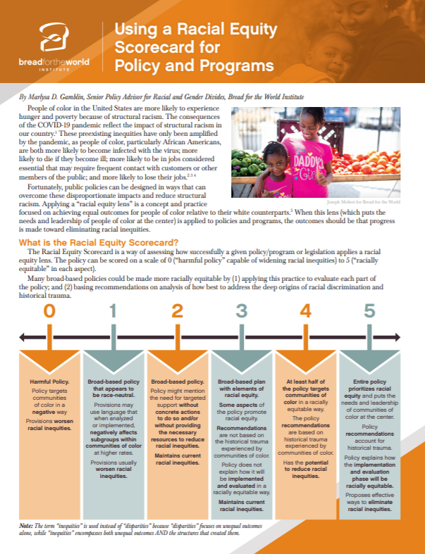
Next Steps
Also use the Racial Equity Scorecard to analyze and rate how well policies are promoting racial equity! Go to bread.org/racialequity to use it!
Download the simulation at bread.org/simulation
Notes:
“You can also use the Racial Equity Scorecard to help you analyze and rate how well policies and programs are promoting racial equity. We can do this when we vote. We can do this in the policies as advocate for. We can do this for the programs we implement or even design ourselves. Similar to the last tool, the designer of the simulation is also the author of this tool as a direct follow up to the work needed after the simulation.”
Scorecard Link: http://votingrecord.us/pdf/racial-equity-scorecard-policies.pdf

Slide 76
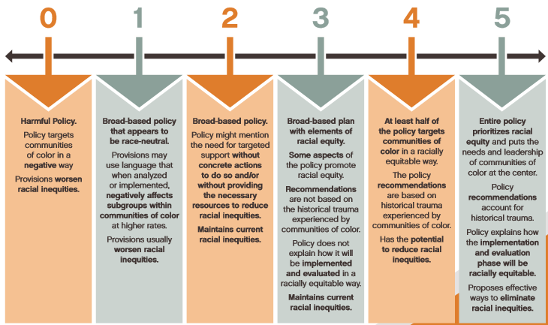
Next Steps
5 core principles of promoting racial equity in policy:
Principle 1: Center the needs, leadership and power of communities of color first.
Principle 2: Name and consider each community of color individually, avoiding terms such as “minority.”
Principle 3: Analyze the specific outcomes for each racial and ethnic group.
Principle 4: Set up policies and programs that are responsive in a way that is proportionate to the disparate impacts.
Principle 5: Include a robust implementation and monitoring plan.
Also use the Racial Equity Scorecard to analyze and rate how well policies are promoting racial equity! Go to bread.org/racialequity to use it!
Notes:
Explain each column and read each principle.
Scorecard Link: http://votingrecord.us/pdf/racial-equity-scorecard-policies.pdf

Slide 77
Racial Wealth Gap Learning Simulation
NEXT STEPS
Share this simulation with your community and networks! Go to bread.org/simulation
Read the Policy Packet! Go to bread.org/simulation_policypacket
Start using the Racial Equity Methodology and Racial Equity Scorecard! Go to bread.org/racialequity to access both tools. You can use these tools as you…..
1. Rate how well a policy, program, or other response promotes racial equity.
2. Decide what policy to support based on this rating.
3. Identify which elected official has a policy agenda that is racially equitable that will help us end hunger.
4. Advocate to your member of Congress or senator for more racially equitable policies.
5. Design your anti-hunger program, start research, and analyze policies to end hunger in a racially equitable way.
Download the simulation at bread.org/simulation

Slide 78
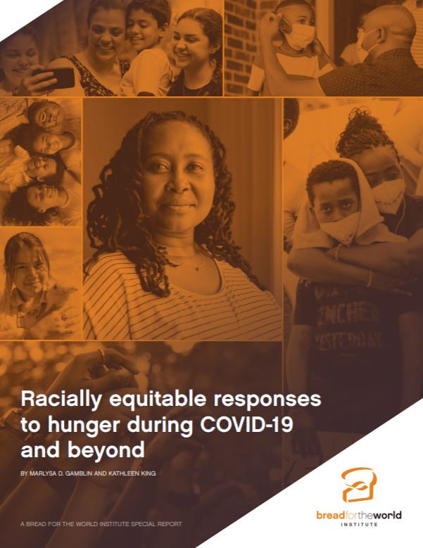
Racial Wealth Gap Learning Simulation
What’s Next for COVID?
This report provides racially equitable responses to address the systemic racism that you learned about today, that has only widened during the pandemic.
Go to bread.org/racialequity
Download the simulation at bread.org/simulation
Notes:
“Given the fact that we have to recover from the pandemic, many of us are asking ‘what’s next with COVID?’ This report is written by the designer of the simulation, Marlysa D. Gamblin, to answer just that. It provides racially equitable responses to address the systemic racism that you learned about today, that has only widened during the pandemic. Go to bread.org/racialequity o access the report.”
Report Link: https://bread.org/sites/default/files/downloads/racially-equitable-responses-to-hunger-during-covid-19-january-2021.pdf?_ga=2.115221767.180694488.1613174078-312380616.1613174078

Slide 79
Racial Wealth Gap Learning Simulation
Want to access the simulation?
Go to bread.org/simulation
Want to access racial equity tools and learn more on racial equity + hunger?
Go to bread.org/racialequity
Download the simulation at bread.org/simulation

